Slide 1
Capturing impact: A practical toolkit for nurse consultants

Slide 2
Practical resource
Evidence based – developed through our research study
Draws on the framework of impact, practicalities of capturing impact & lessons learned
Activities and examples
Positive feedback from nurse consultants and nurse managers

Slide 3
Toolkit contents
Introduction to the toolkit & how to use
Section 1 – Capturing Impact
Section 2 – Your impact – identifying areas & priorities
Section 3 – Guidance on capturing impact
Section 4 – Evaluating economic aspects
Section 5 – Examples of capturing impact
Section 6 – Who needs to know about your impact?
Section 7 – Examples of tools

Slide 4
Introduction
Not an exhaustive guide, but practical assistance to:
Identify key areas of impact relevant to your post
Assess barriers/facilitators
Consider different approaches to demonstrate your impact
Who might find it useful?
Developed for use by nurse consultants – new & established
Line managers
Other advanced practice nurses (e.g. CNS, NPs)
Allied health professionals in consultant roles

Slide 5
Section 1: Capturing impact
What do we mean by impact?
‘Influence’ or ‘difference’ brought about by providing a service or having you as a NC in post.
‘Added value’ to the organisation / what’s unique?
Difference between process and outcome
Process – what you do in your role (e.g. 4 core functions)
Outcome – end result & impact you have through the activities you engage in

Slide 6
Variety of reasons you might want to capture your impact
Who are the stakeholders for your post and what impact is important to them?
Activity 1 – identifying stakeholders for your post
Valuable insights into your impact
Tool 1 (page 43) could be used to gather stakeholder views

Slide 7
Section 2: Your impact – identifying areas & priorities
What do you do on a day-to-day basis? (Activity 2)
What impact do these activities have? (Activity 3)

Slide 8
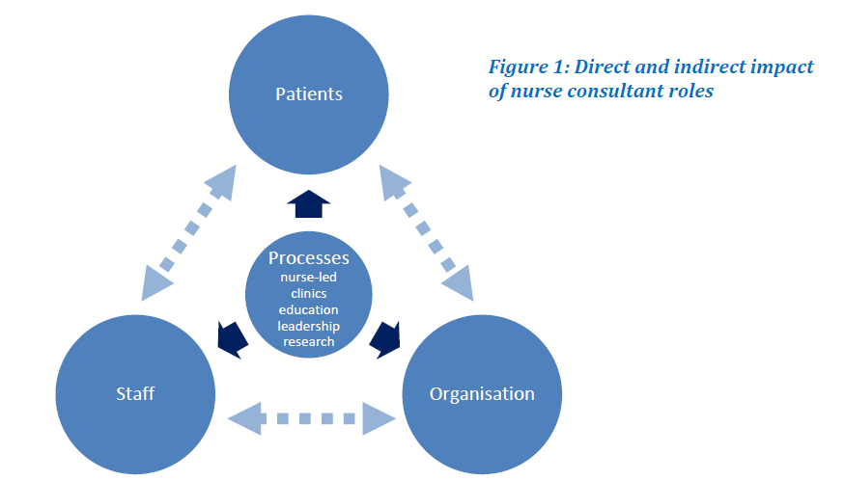

Slide 9
Framework of impact
Activity 4 – identify examples of impact from your own work relating to the different areas
Patients
Staff
Organisation
Not all may apply to all roles
Some outcomes may apply to more than one domain (e.g. smoking cessation)
Use flexibly/degree of personal judgement

Slide 10
Most important areas currently
Cannot capture every impact!
Need to prioritise
Worthwhile exploring impact in all 3 domains (including indirect impact through the work of other staff…)

Slide 11
Section 3: Guidance on capturing impact
Activity 6: Assessing the barriers & facilitators to capturing evidence of impact

Slide 12
What approaches might be used to capture impact (e.g. existing data, quantitative, qualitative)
Key issues/questions to ask relating to using the different approaches

Slide 13
Section 4: Economic aspects
Worked with two health economists who developed a framework for evaluating economic aspects of the role

Slide 14
Section 5: Examples of capturing impact
Specific examples from the NCs involved in the study or published literature relating to the 3 domains and their specific indicators

Slide 15
Section 6: Who needs to know
Influenced by initial reasons for capturing impact but may include:
Managers making decisions about service developments
Annual appraisal with line manager
Trust Board
Senior nurse managers
Important in raising your profile & visibility in the Trust & externally

Slide 16
Section 7: Examples of tools
Copies of the tools referred to in the examples presented in Section 5
May need to adapt to suit specific needs
Not presented as the ‘best’ tools available – you may already know of better ones in your speciality
Individual copies are available on our website: http://research.shu.ac.uk/hwb/ncimpact
Advised to contact the authors for permission to use/adapt their tools

Slide 17
A few concluding remarks…
Hopefully a practical, pragmatic/realistic guidance
However:
Limited piloting of tools
We gave NCs support during piloting phase
Needs further validation

Slide 18
‘It should be in the induction pack for new nurse consultants’
'If new to post I’d find the toolkit very useful but also it’s useful for nurse consultants to reflect on their practice and provide evidence to support and improve practice'
'I could see it forming part of performance review and my own portfolio/record of progress'
‘Once you’ve got the mindset, you will be able to collect the data to demonstrate impact as part of day-to-day practice’
Notes:
BUT WE WANT TO KNOW WHAT DO YOU THINK??

